Slide 1
Core Java
Andy Chen

Slide 2
Topic : String
String is immutable
String str1 = “abc”; String str2 = new String(“abc”); String str3 = “abc”; String str4 = str1 + str2;
Reference vs Value: 1) str1 == str2 ? 2) Str1.equals(str2) ? 3) str1.compareTo(str2)
Constant Pool: How many objects ? (Pool)
Built-in Functions: charAt(), length(), substring(,), contains(), equals(), toUpperCase()
StringBuilder & StringBuffer
StringBuilder sb = new StringBuilder(“abc”); sb.append(“abc”);
sb.append(“abc”); sb.reverse(); sb.delete(startIndex, endIndex)
Mutable
toString()
Synchronized vs non-synchronized

Slide 3
Topic: final
Variable :
public static final String APP_NAME=“testApp”
Purpose: define constants
Method:
public final int add(int a, int b){ return a + b; }
Purpose: prevent override
Class:
final class MyClass(){}
Purpose: 1) prevent inheritance, like Integer, String etc; 2) Make class immutable
Difference: final, finally, finalize

Slide 4
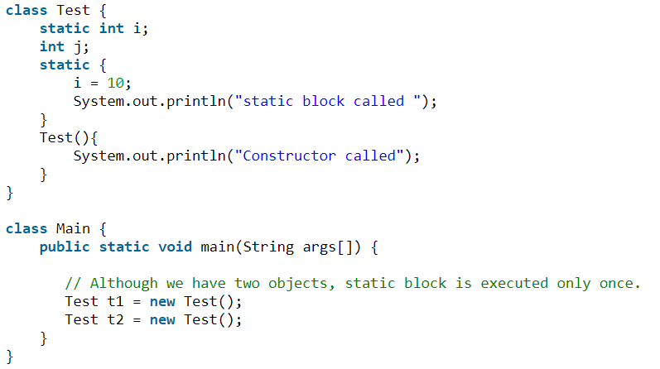
Topic: static
Blocks; Variales; Methods; Nested Classes
Only One Instance!
1) Static Block/Variable
Question
1. Java Variable Scope ?
2. scope of static block ?

Slide 5
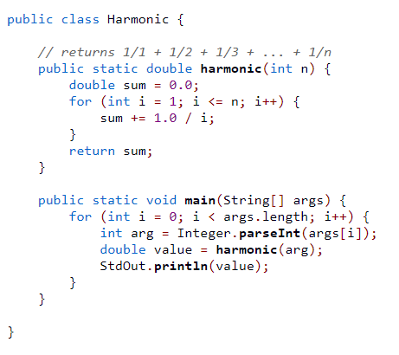
Topic: static
2) Static Method
Question:
1) Can static method access non-static variables ?
2) How to call static method in/outside of enclosing class?
3) Common Static Methods?
4) When to use static Methods?

Slide 6
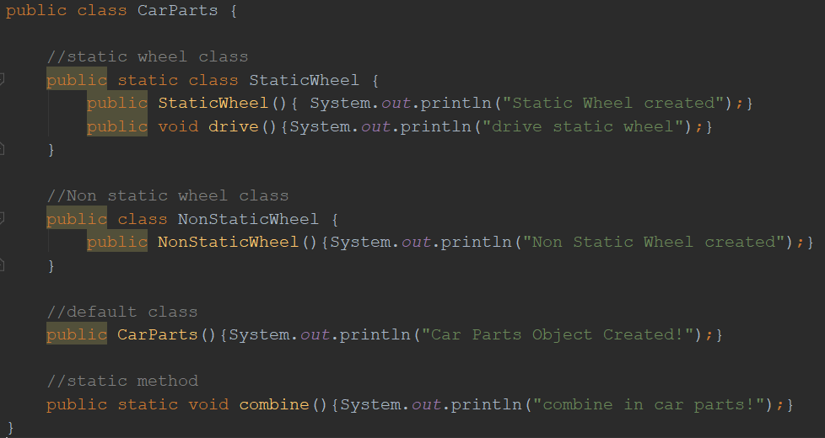
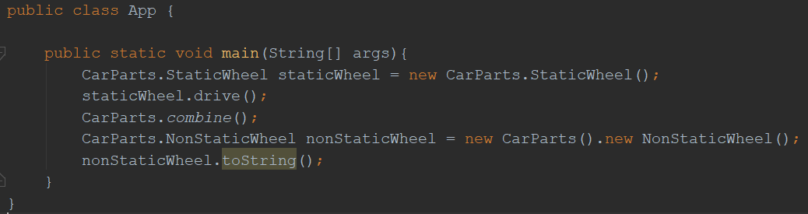
Topic: static
3) Static Class

Slide 7
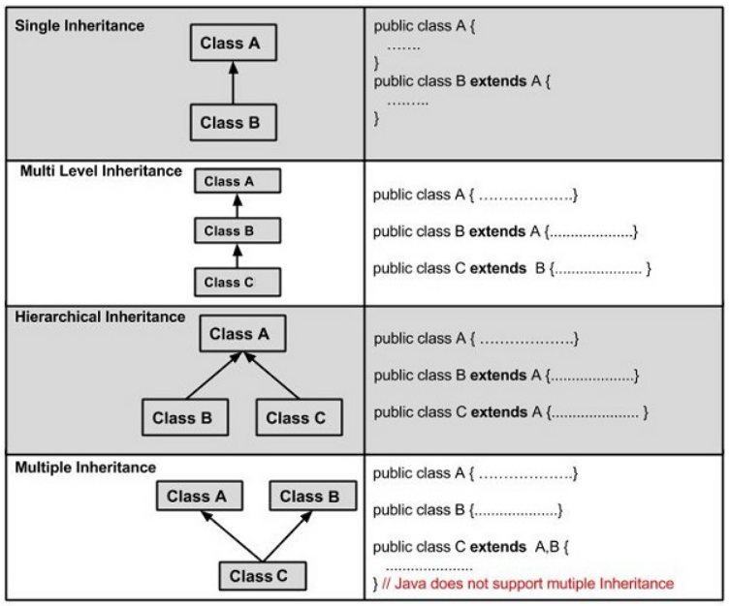
Topic: OOP(PIE)
Inheritance
Extends: Class
Implements: Interface
Question:
1. Abstract Class
2. Abstract class vs Interface
3. Marker Interface (Serialization)
Tips:
> Multiple Inheritance (extends) is not allowed
> Multiple Implementation (implements) is allowed
> Use “super()” to access parent class

Slide 8
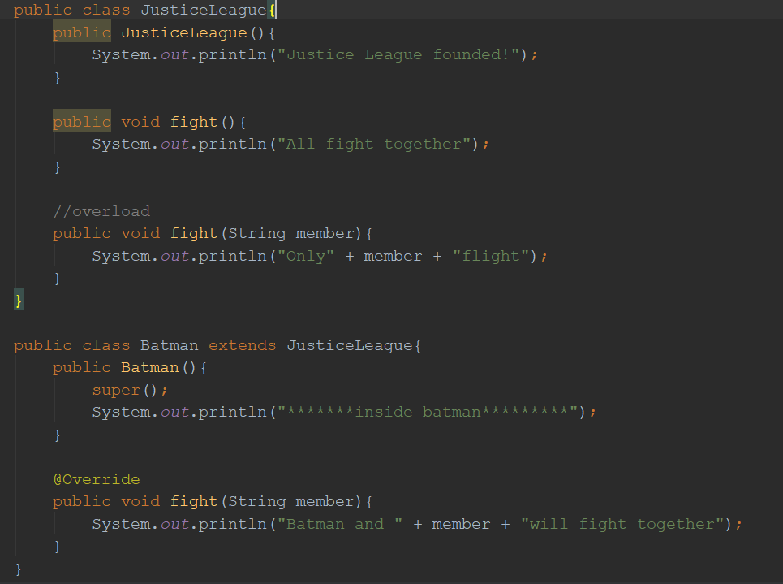
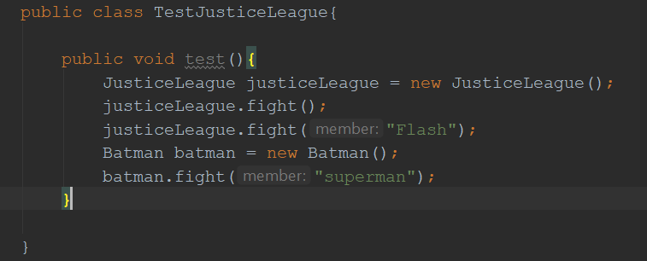
Topic: OOP(PIE)
Polymorphism
Static Polymorphism / Dynamic Polymorphism
Overload (same class) / Override (child class)
Question: output from test()

Slide 9
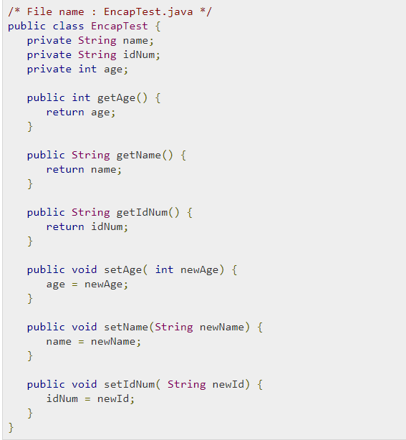
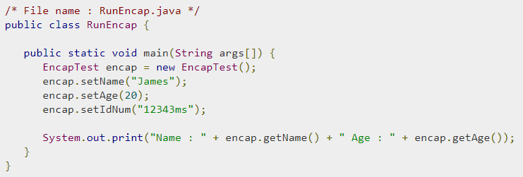
Topic: OOP(PIE)
Encapsulation
Tips: use getter/setter instead of direct access
Industry standard code structure
RTIME project walk through
(FrontEnd -> Controller -> Service -> DAO -> Database)

Slide 10
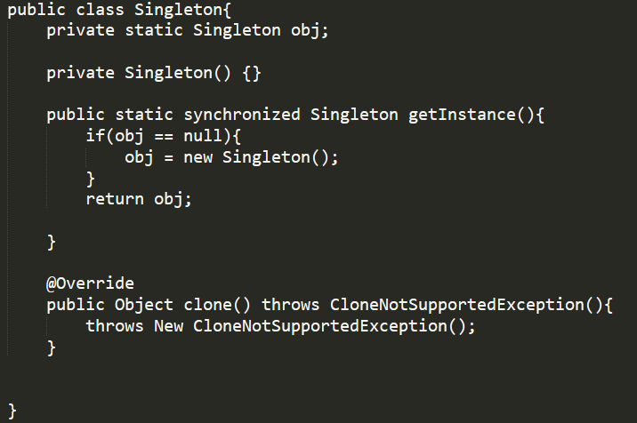
Topic: Design Pattern (Singleton)
Steps to make singleton
1. private Constructor
2. static getInstance method
3. synchronized
4. override clone() method
Disadvantage of Singleton
1. it carries state of object
2. it prevents dependency injection and cannot be unit tested
1
2
3
4

Slide 11
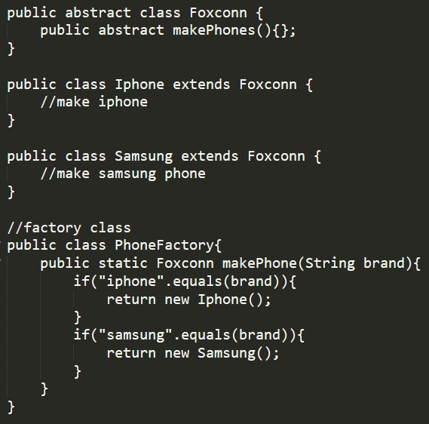
Topic: Design Pattern (Factory)

Slide 12
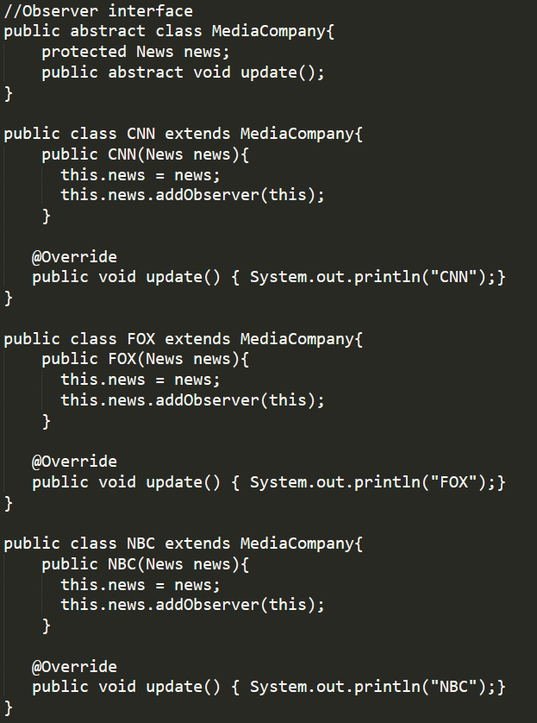
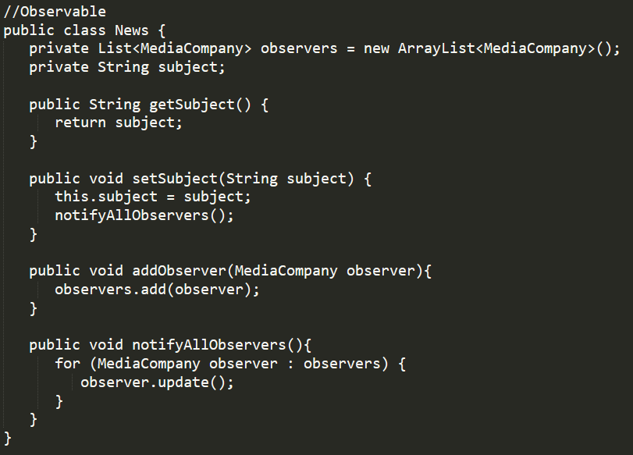
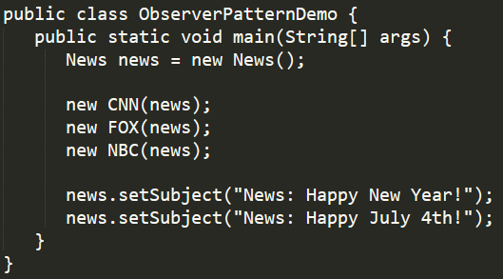
Topic: Design Pattern (Observer)
It is similar to “subscribe” in Angular/Redux and Reactive Programming

Slide 13
Topic: Design Pattern (Others)
Popular Design Pattern to choose:
Decorator, Façade, Strategy, Builder, Composite etc
DO NOT SAY “MVC”

Slide 14
Topic: Real Scenario
1. Design a TO-DO list
2. Design an Elevator System

Slide 15
Topic: Collections
List (Vector, ArrayList, Set, LinkedList)
HashMap, ConcurrentHashMap, TreeMap, HashTable
Principle of HashMap
Equals() and HashCode()

Slide 16
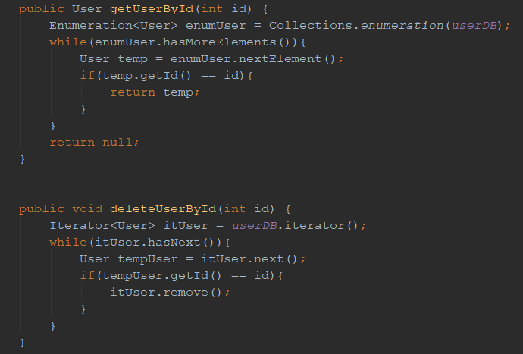
Topic: Iterator vs Enumeration

Slide 17
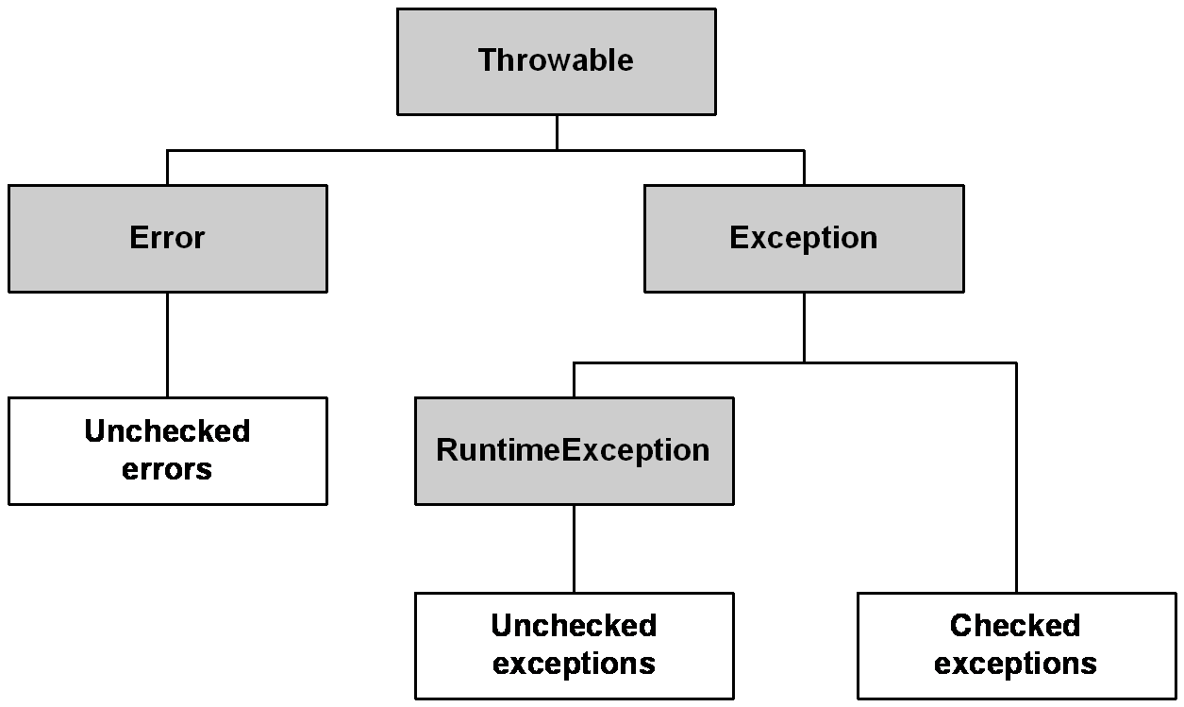
Topic: Exception Handling
See RTIME project for customizing exception

Slide 18
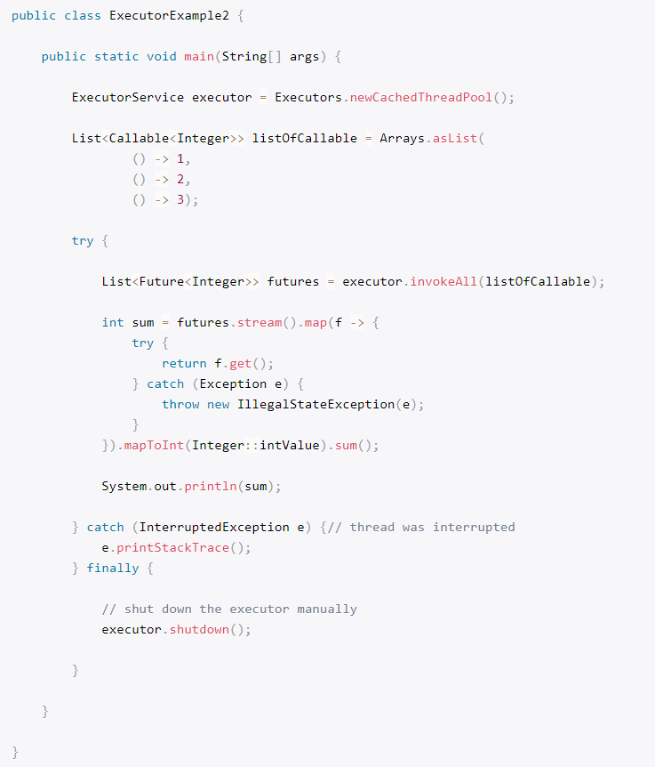
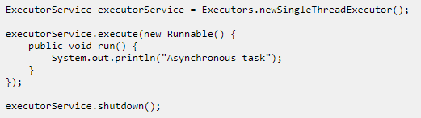
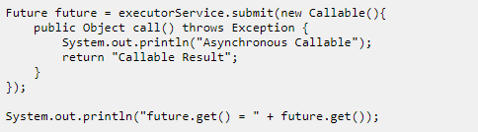
Topic: ExecutorService
ExecutorService maintains thread pool
Executors.newCachedThreadPool()
newFixedThreadPool()
Execute(), submit(), invokeAny(), invokeAll()
Runnable vs Callable
Future.get(*time), Future.isDone(), Future.cancel()
Executor.shutdown()

Slide 19
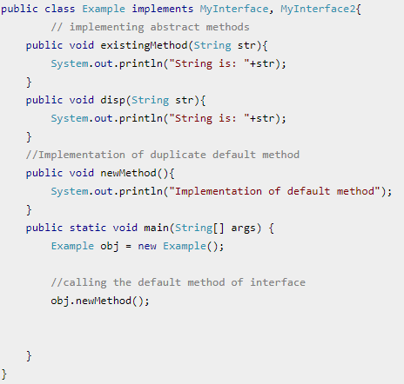
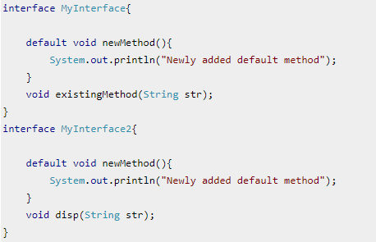
Topic: Java 8(default & static methods)
Problem with java interfaces: children must implements all methods in interface, if adding new definitions to interface, all children have to update.
Solution: default methods in interface
Problem: multiple implementations –> override
Static methods: the same as defaults method,
but does not allow override

Slide 20
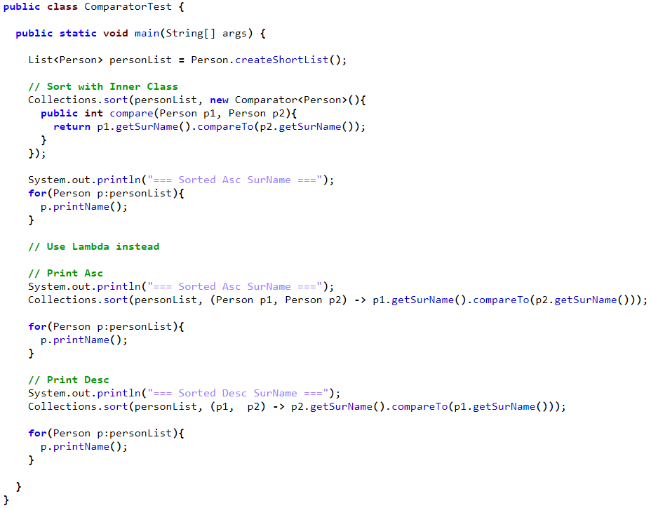
Topic: Java 8(lambda)
Why introducing lambda?
To replace anonymous inner class
Can rewrite any methods
Work with functional interface (next slide)
Scope of lambda:
Enclosing block
Tooltips:
Avoid large block of code and “return”
Avoid () around single input
Avoid input type

Slide 21
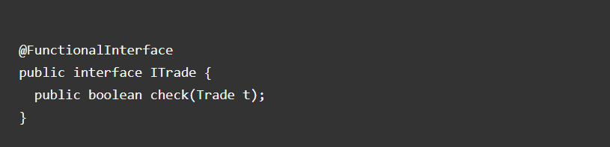
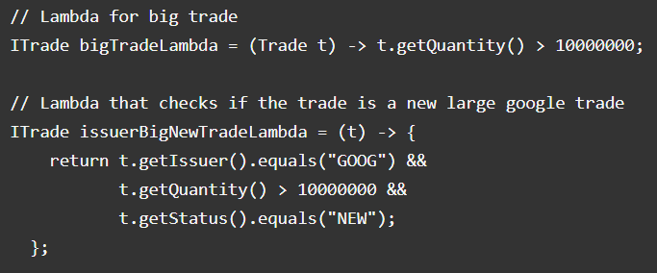
Topic: Java 8(Functional Interface)
has one Single Abstract Method
@FunctionalInterface – for sanity check
Can have default methods
Lambda is the implementation of the abstract method

Slide 22
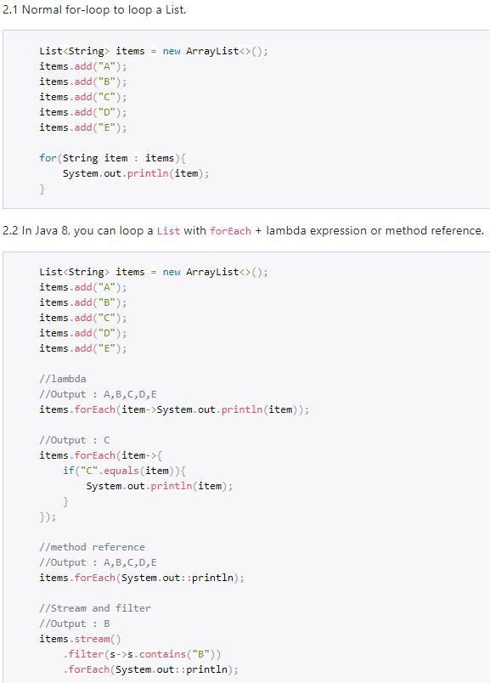
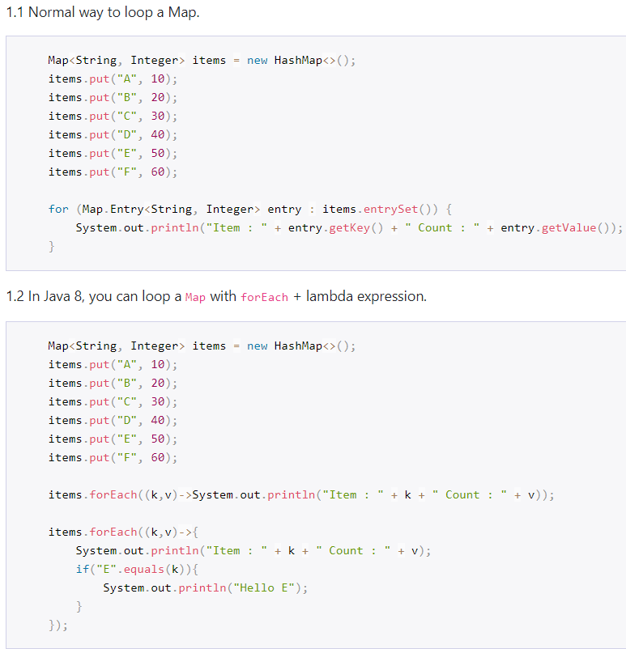
Topic: Java 8(forEach)

Slide 23
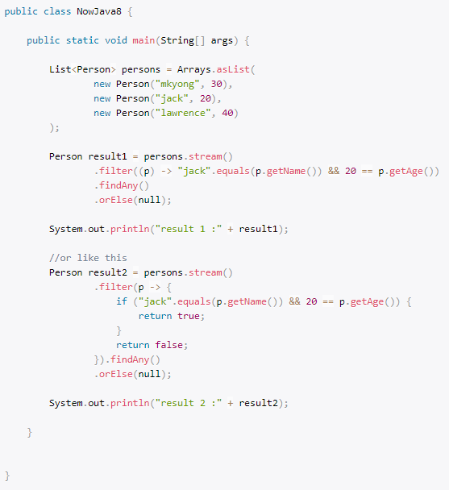
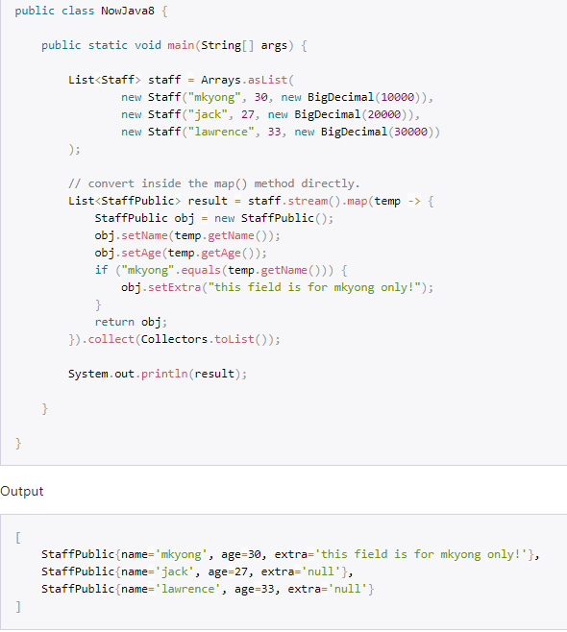
Topic: Java 8(stream)
filter map

Slide 24
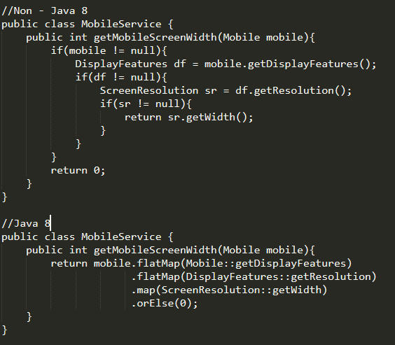
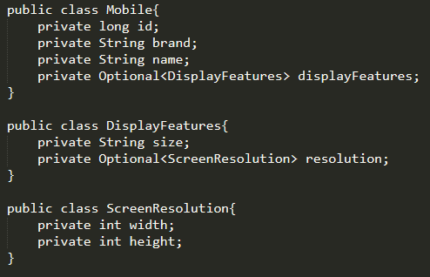
Topic: Java 8(optional)
To avoid Null checks and run time NullPointerExceptions

